Slide 1
The Boston Fitness Venue Industry and Data Visualization with Choropleth Maps and Histograms
By William Scott Breckwoldt

Slide 2
Introduction
I will be using data wrangling and cleaning from various sources and data visualization with Folium, GeoJson, and MatPlotLib. I will create histograms and interactive choropleth maps that demonstrate the characteristics of each neighborhood that may affect fitness venue membership or attendance. I hope to conclude this project by providing those looking to open a fitness venue in Boston with some useful information about the area.

Slide 3
Data Wrangling
First, I would need to gather general information on the fitness club industry and its customers looking specifically for factors that may lead to a gym’s success. I found useful sources for information of the fitness. club industry such as the IHRSA and IBIS. I also found useful information on the neighborhoods on data.boston.gov and realestate.boston.com

Slide 4
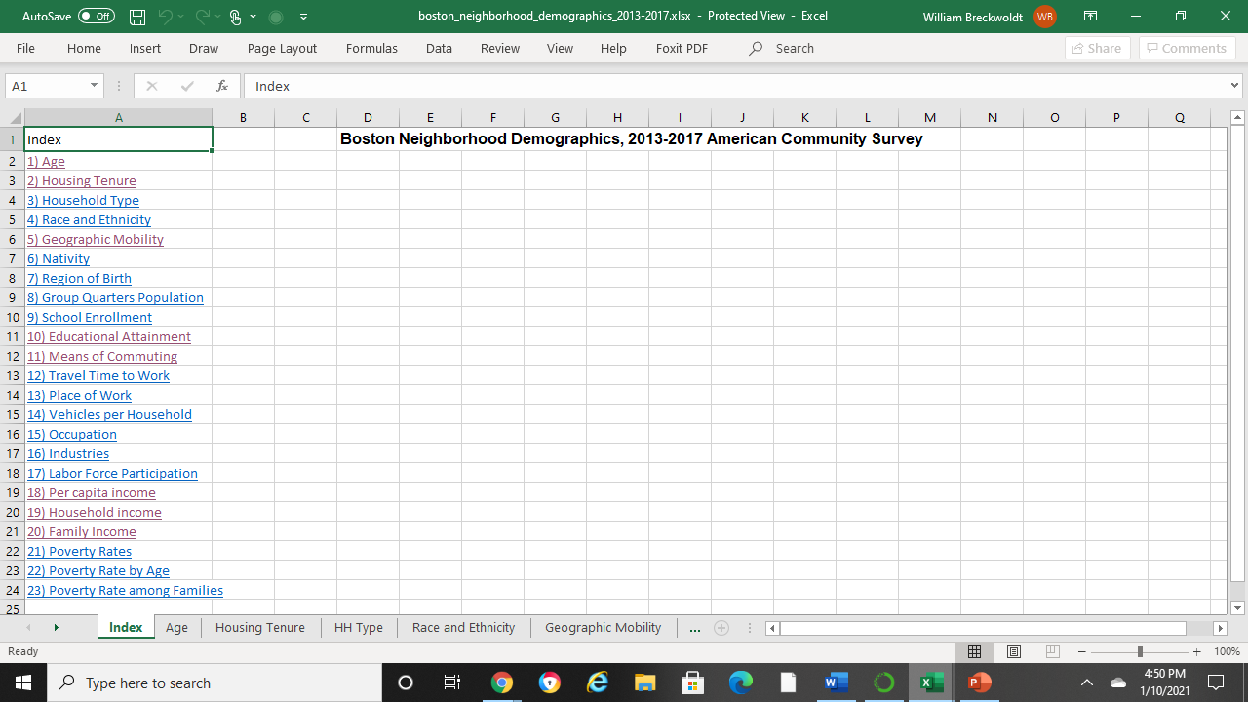
data.boston.gov data
I used Boston Neighborhood Demograhics, 2013-2017 American Community Survey from data.boston.gov to get the population, median household income, education attainment, and age distribution of the neighborhoods which I added to a worksheet in Excel. Also, a median monthly rents for a one-bedroom column was added thanks to realestate.boston.com to give us an idea of the property price of the various neighborhoods.

Slide 5
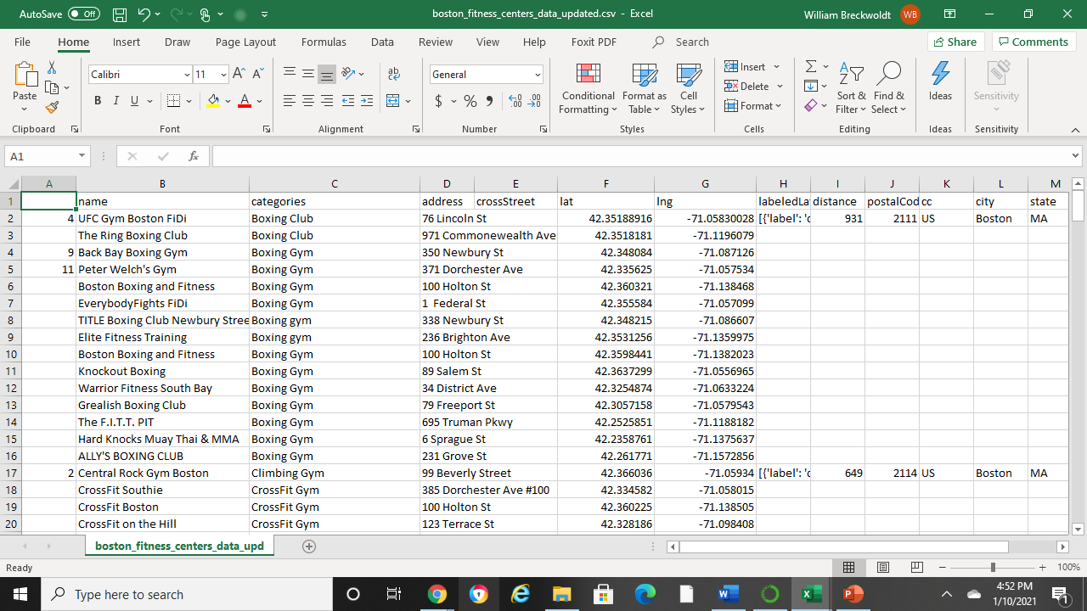
Gather the Venues
Gathering the addresses and coordinates from all the fitness venues I could find on google maps, was lengthy, but successful. After, I downloaded a GeoJson file from data.boston.gov that would allow me to outline the Boston neighborhoods and use them for my choropleth maps.

Slide 6
Methodology
After cleaning the data, I had what I would need to make the data visualizations that I wanted. I am going to make folium maps, as well as MatPlotLib to make histograms. The choropleth maps will have markers of the fitness venues colorized by category and will also demonstrate the population, median household income, percentage of population 20 to 34 years old, and percentage of population with a bachelor’s degree or higher.

Slide 7
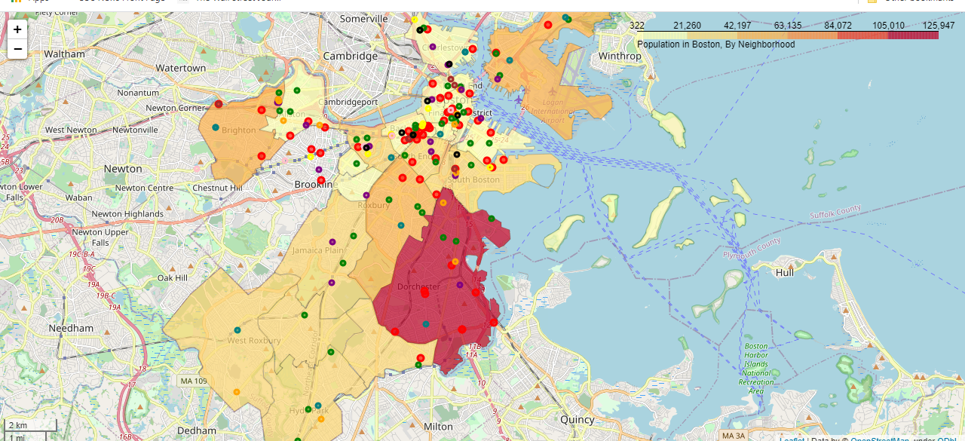
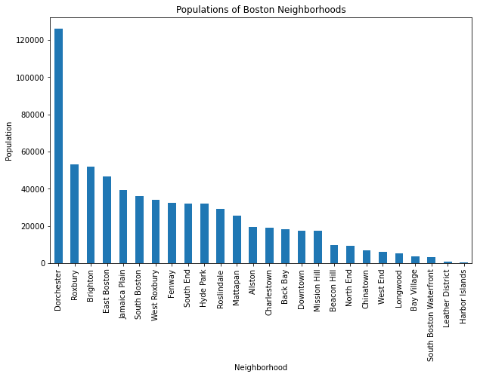
Population
"Numerous health club demographic studies show that upwards of 80% of a club’s members come from within 12 minutes travel time of the facility. Travel should mimic the realistic route used by a local resident to the club site" (IHRSA, 2020).

Slide 8
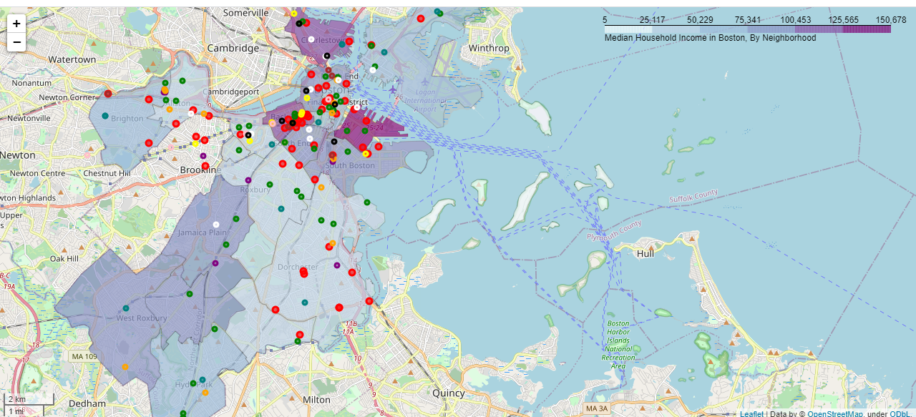
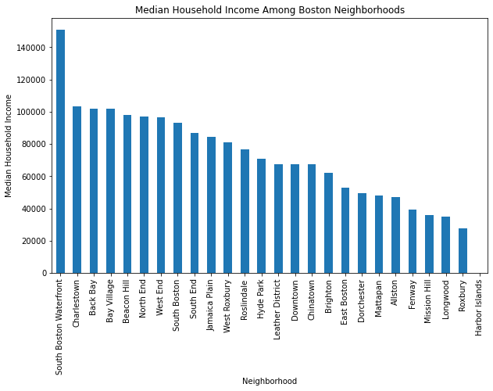
Median Household Income
"Household income is [...] a key determinant of club pricing. In general, in markets where the average household income is $75,000 or more, such a community can support dues pricing in the $60 to $125 range. Conversely, when household income falls below $25,000, only one out of every 14 (7.2%) people is a health club member" (IHRSA, 2020).

Slide 9
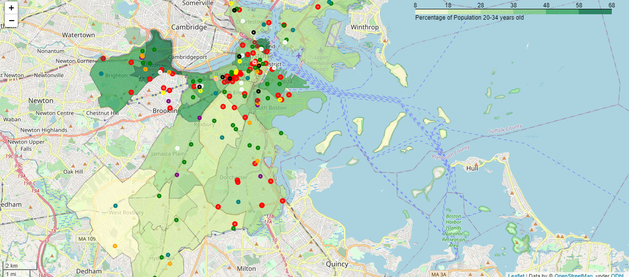
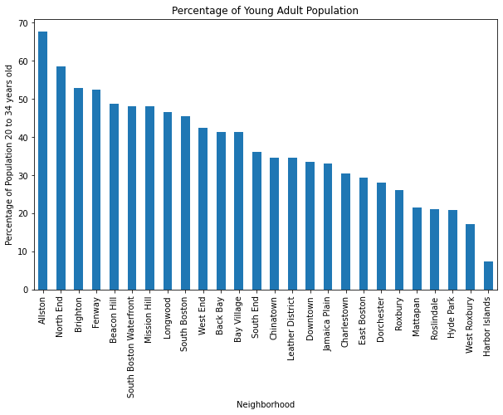
Percentage of Population 20 to 34 Years Old
Additionally, "81% of Millennials exercise or would like to compare to 61% of boomers, according to a Nielsen survey.
In 2018, adults between the age of 18 to 24 were most likely to meet the recommendations for aerobic physical activities.
The 18-25 years old generation are more likely to attend fitness studios than other age groups" (IHRSA, 2020).

Slide 10
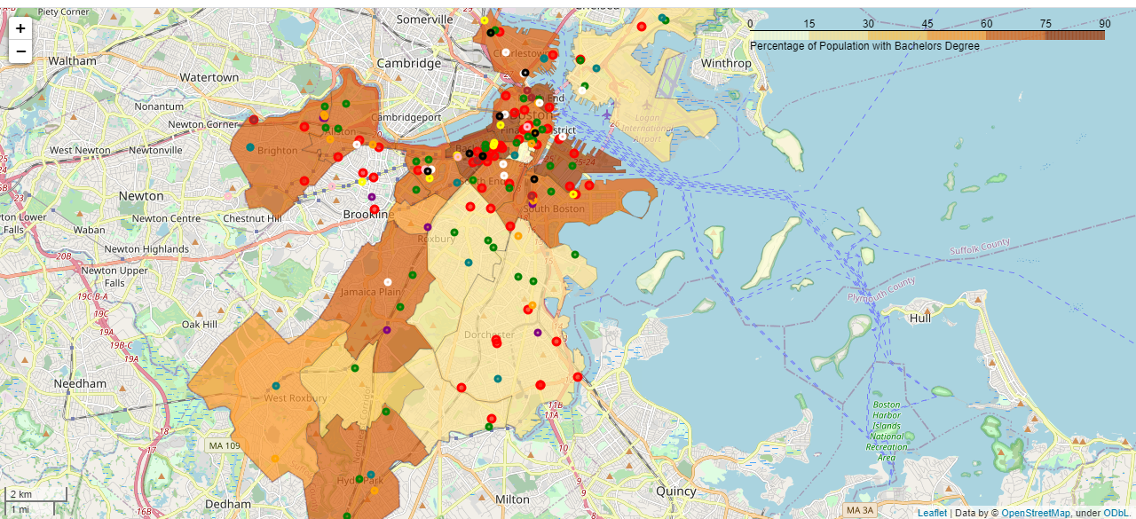
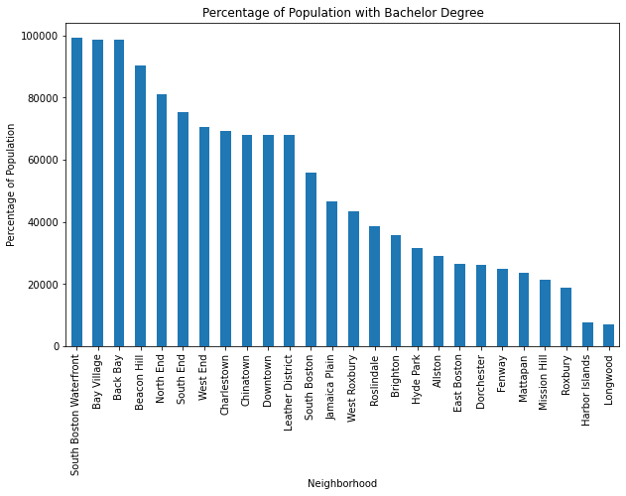
Percentage of Population with a Bachelor’s Degree
Lastly, "the overall health club penetration rate among full-time college students is 24%; the health club penetration rate among men and women with advanced degrees (business degrees, law degrees, medicine, etc.) is 25.2%. Conversely, among men, who earn $75,000 or more, but who did not go to college, the penetration rate is 11.6%" (IHRSA Health Club Business Handbook, written by John McCarthy and sponsored by ABC Financial).

Slide 11
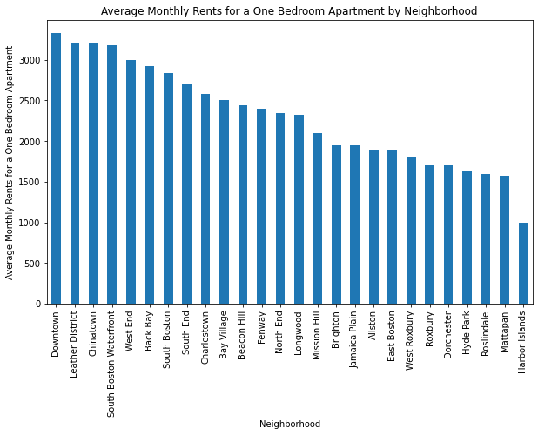
Median Monthly Rent by Neighborhood
Here we can see the rent varies pretty drastically by neighborhood.
Notable is how low rent in Dorchester, West Roxbury, and Jamaica Plan compared to Downtown and its surrounding areas.
Except for Beacon Hill and the North End

Slide 12
Results
Dorchester has the largest population by far and it haslow rent and there are not any fitness centers in North Dorchester, however, it has a low median household income, along with Mattapan, Mission Hill, Longwood, Fenway, East Boston, and Allston. Downtown (including Chinatown and the Leather District) has the highest rent and already has plenty of fitness venues. Back Bay and Bay Village are also expensive and have plenty of fitness venues.
Jamaica Plain and Beacon Hill look like the best places to open a fitness venue according to these maps. Both have a high percentage of population with a Bachelor's degree and both have few fitness venues in the area. Jamaica Plain has a higher population and lower rent while Beacon Hill has the highest percentage of population with a bachelor's degree and a large young adult population.

Slide 13
Discussion
This project shows a good overview of the fitness club industry in the area by demonstrating the demographics and markers for all the fitness venues. However, it is far from being the reason to open a gym in the area.
Boston is a very developed city, there may be a reason there are fitness venues in Beacon Hill. Google maps could also be missing fitness venues or my data needs to be updates.
Also as a result of COVID-19, many fitness center venues have shutdown and people are starting to turn to home workouts and exercise so this project may not be useful until peope are returning to the gym.
I think this project would be a lot more useful if I could be more exact. If I could find a specific block or even property that would be ideal for opening a fitness venue, that would make this project this much better. Dividing the city up by postal code could be an option but then I would need to find data for postal codes.

Slide 14
Conclusion
Although I was able to locate what looks like a couple good neighborhoods to open a fitness venue, I feel that this project needs more data. There is not a lot of research or studies open to the public done on gym attendance and membership, but the IHRSA was helpful. I cannot be entirely sure if opening a gym in Beacon Hill would be a good financial decision either. Furthermore, I would have to look at the "For Sale" properties in the areas to determine where the very best locations would be. Nonetheless, this project provides a good overview of Boston's fitness club industry and would be helpful for someone interested on the topic. It could be even more useful with more knowledge of the fitness industry and individual fitness venues.

